Slide 1
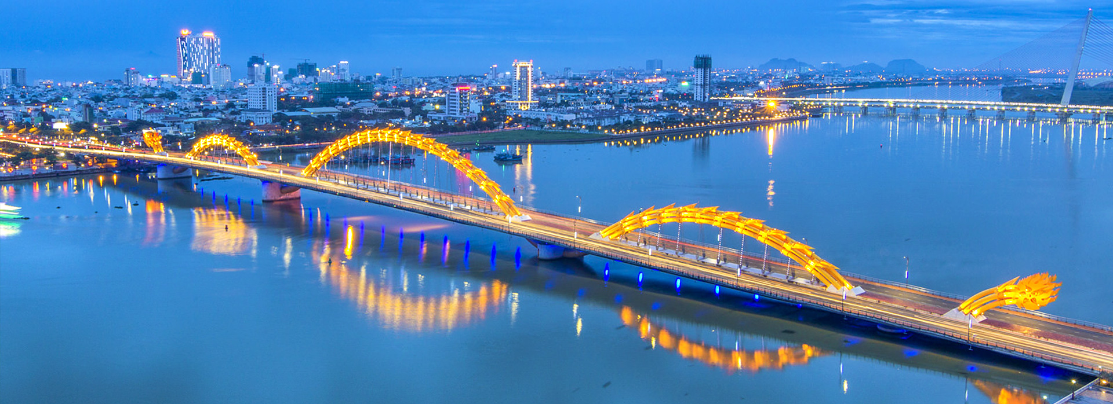
Đà Nẵng City

Slide 2



Da Nang
Geography
Advantages
Disadvantages
Attractions
Classic attractions
Recently added attractions
Statistics and Strategies
Potential
Reality
Recover plan

Slide 3
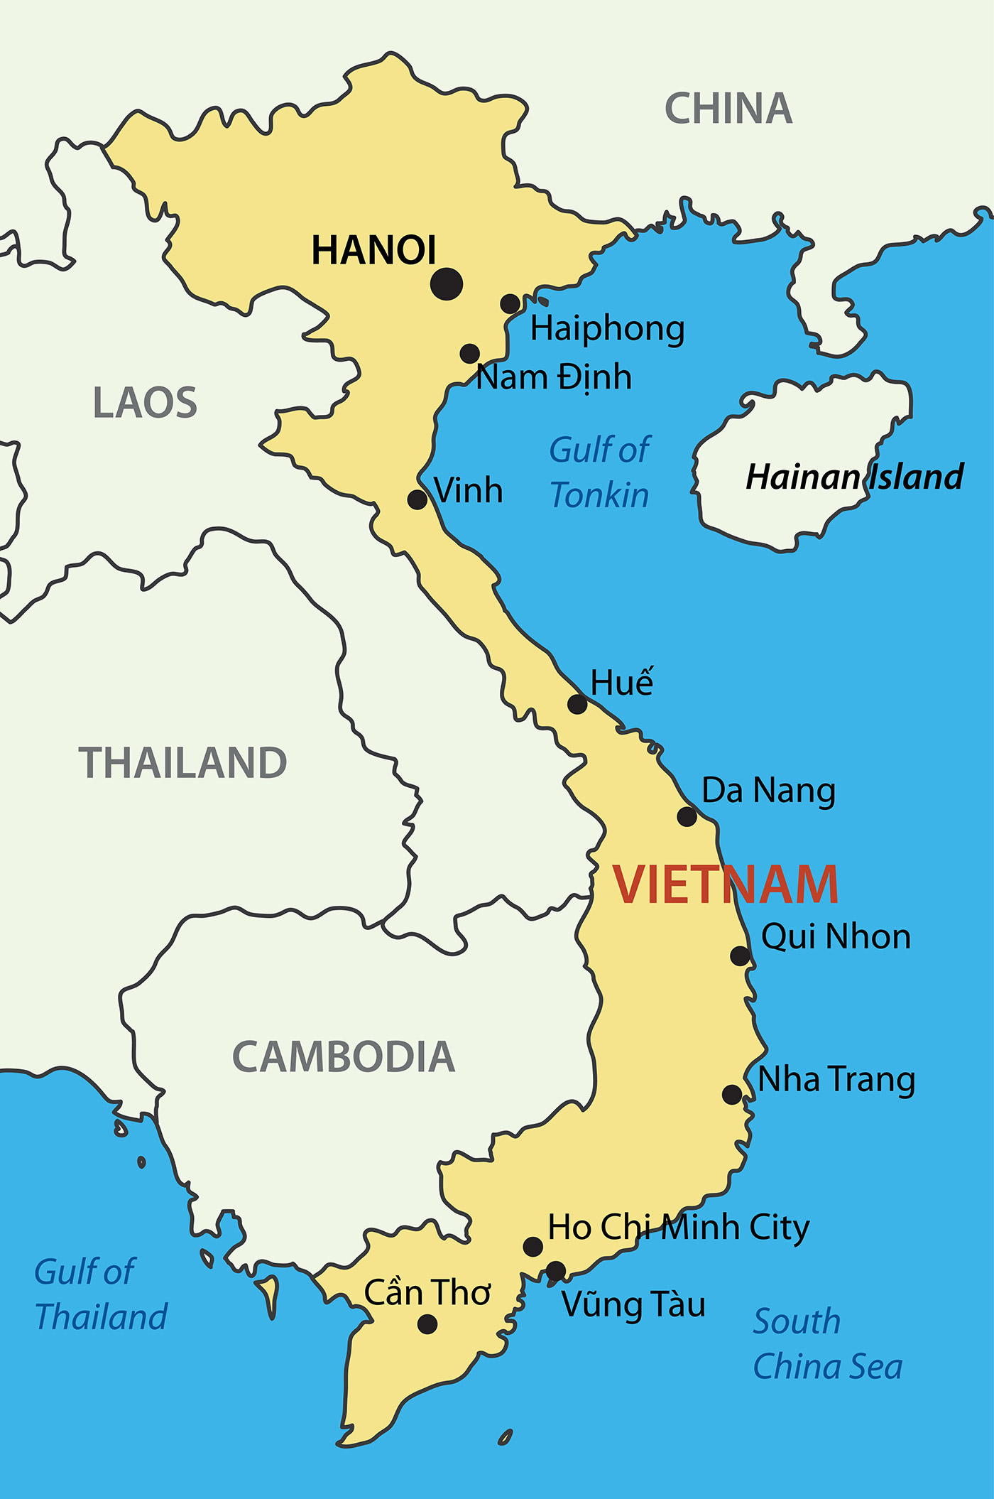
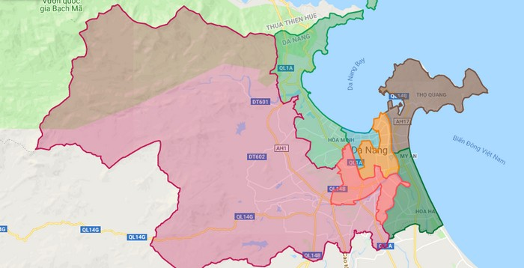
Geography

Slide 4


Geography
Da Nang’s climate is a dichotomy between meteorological patterns:
Exhibiting intermittent rains, showers or even cyclones from September to December.
A dry, somewhat scorching weather from January to August.
Climate

Slide 5
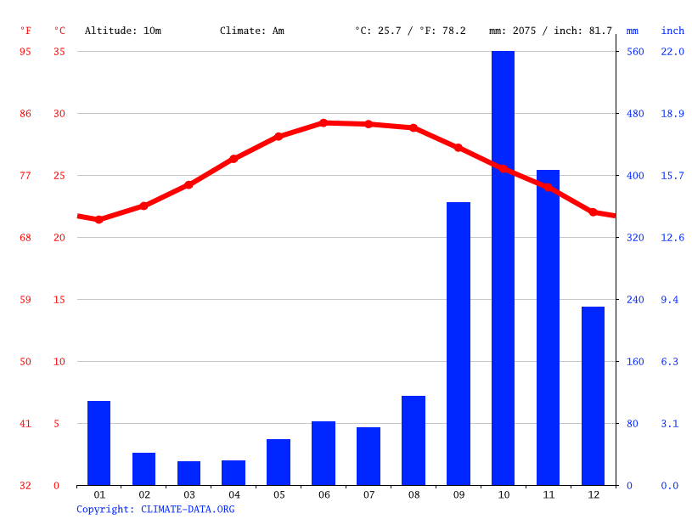
Geography
Climate
The temperature peaks are observed mostly during summer, or from June to August and ranging from 28 to 30 degree Celsius.
Humidity in these months are also particularly low, from 75 to 77%, with appropriate level of rainfall during said period.

Slide 6



Geography
Advantages
Disadvantages
One of the vital port cities of Vietnam.
→ A main transportation hub for domestic and foreign travel.
Tropical climate.
→ Tourism development, specially Summer and Spring.
Intermediary position.
→ Allow for two-way traffic from North to South of Vietnam.
Natural disasters such as storms, tsunamis, earthquakes.
The fact that travelers can visit so conveniently might backfire.

Slide 7
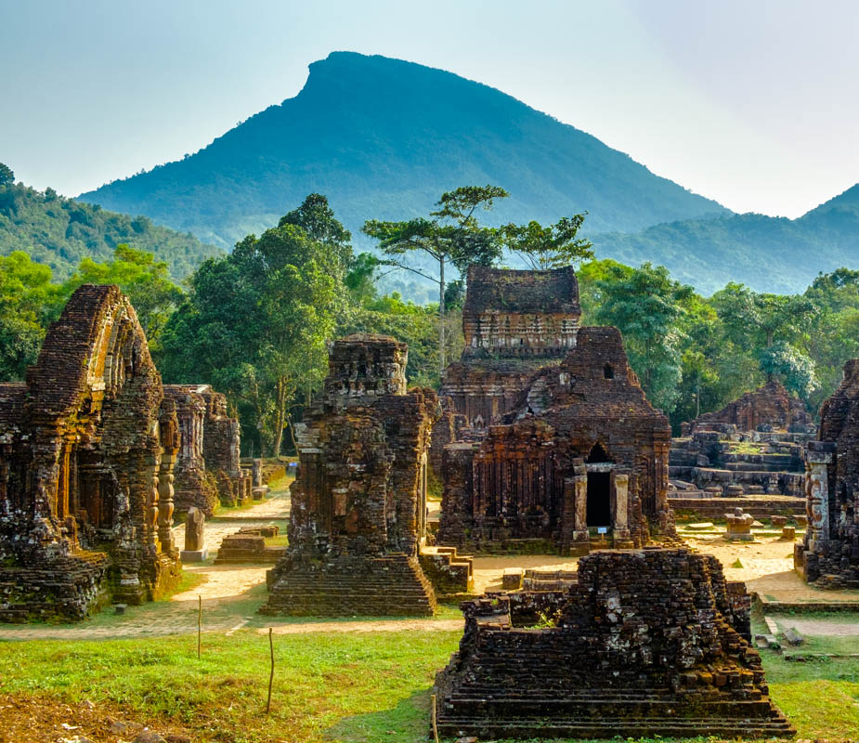
Attraction
My Son ruins
An archaeological site dated more than a millennium.
Former capital of the Champa kingdom.
Boasts more than 20 unique structures on-site.
Relocated to the Cham Museum.
Recognized as a World Heritage by UNESCO.

Slide 8
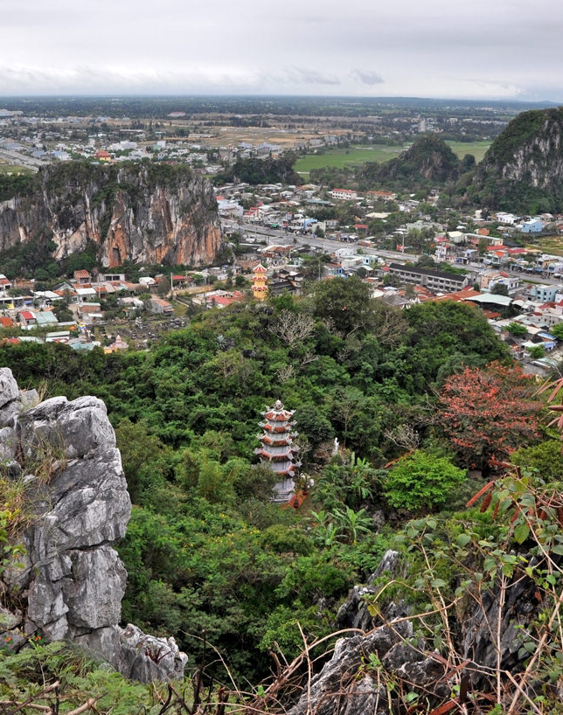
Attraction
Marble Mountains
Limestone deposit protruding out from the beach, to the south of Da Nang.
Interwoven with paths leading to deciduous cliffs, with splendid view upon the beach and East Sea.
The attration offers various religious sites such as ancient pagodas built by the Nguyen Dynasty, and also an artisans’ village at its base.

Slide 9
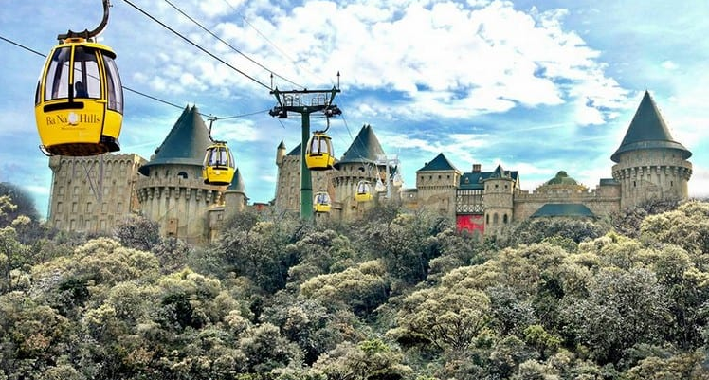
Attraction
Bà Nà Hills
A mountain resort.
Offering a gondola system up to 5-km long.
The top of the mountain is exactly 1487 meters above the sea level.
The location of the famous Golden Bridge.

Slide 10
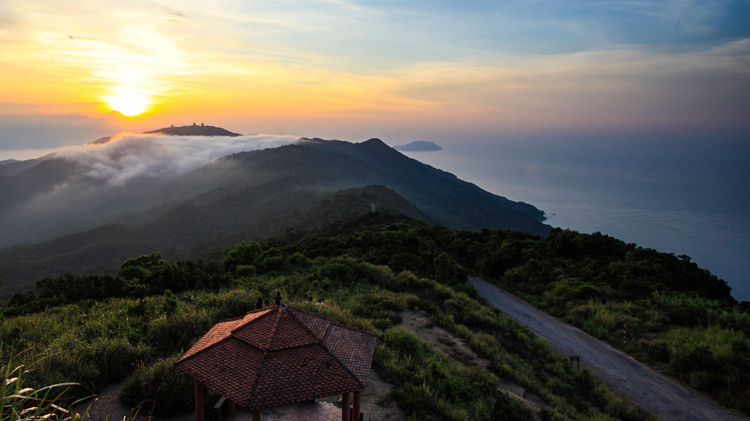
Attraction
Son Tra Mountain
Also known as the Monkey Mountain.
Oversee Da Nang Bay and the East Sea.
Owning the highest Buddha statue in Vietnam – in Linh Ung Pagoda.

Slide 11
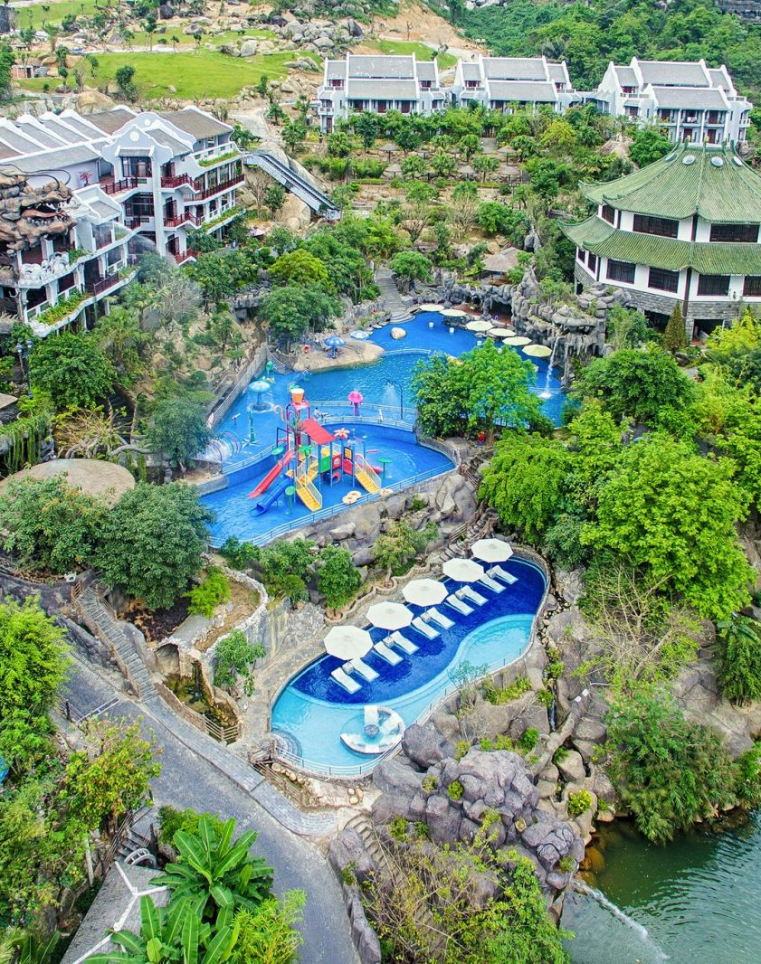
Attraction
Thần Tài Hot Spring Park
Authentic Japanses-style onsen.
Family-friendly, exciting water park.

Slide 12
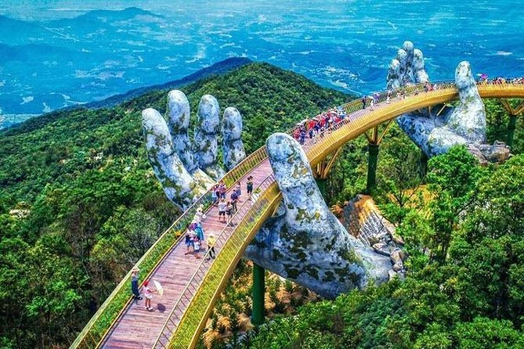
Attraction
Dragon Bridge
Fireworks performance every weekend and festival times.

Slide 13
Statistics and Strategies
Potential

Slide 14

Statistics and Strategies
Reality
Covid-19
In the second quarter, this can accumulate up to an alarming $244 USD.
Decline 50% in international tourists as compared to 2019, 64% for that of domestic visitors.
International flights are unavailable.
Foreign markets are unreachable.
Economic losses from tourism estimated at $77 millions USD in the first quarter of 2020.

Slide 15
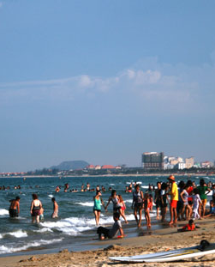
Statistics and Strategies
Recovery Plan
Shift the paradigm towards domestic travelers.
Advertise more effectively on social media sites, news channels, etc.
Offer stimulus package to maintain the city’s attractiveness and tourism infrastructure.
Lessen legal restrictions on Visa, Passports,… for international visitors.
Focus on local countries whose flight paths are sill permitted.
Conduct a wide range of recreational activities.

Slide 16
References
Da Nang People's Committee: https://web.archive.org/web/20181009042731/https://danang.gov.vn/web/en/detail?id=26029&_c=16407111
Đà Nẵng City Informatics Portal: https://danang.gov.vn/chinh-quyen/chi-tiet?id=85&_c=56
BBC News, October 2nd 2006: http://news.bbc.co.uk/2/hi/5394626.stm
Mitchell, J. & Phuc, L. Final Report on Participatory Tourism Value Chain Analysis in Da Nang, Central Vietnam, September 3rd 2007, p.55: https://www.odi.org/sites/odi.org.uk/files/odi-assets/publications-opinion-files/883.pdf
Trinh, T. Et al. "Heritage and cultural tourism: the role of the aesthetic when visiting Mỹ Sơn and Cham Museum, Vietnam", October 22nd 2014: https://www.tandfonline.com/doi/full/10.1080/13683500.2015.1054269?src=recsys
Đà Nẵng's Department of Tourism, May 12th 2020: https://danang.gov.vn/web/en/detail?id=18363&_c=16407387
Việt Nam's Department of Tourism, "Da Nang proposes halting sightseeing fees to tourist attractions", July 7th 2020: http://www.vietnamtourism.gov.vn/english/index.php/items/14900

Slide 17
THANK YOU FOR YOUR ATTENTION

